Slide 1
The promise and pitfalls of AI
Matt Turek, Deputy Director, Information Innovation Office (I2O)
August 2023
Distribution Statement A: Approved for Public Release, Distribution Unlimited.

Slide 2
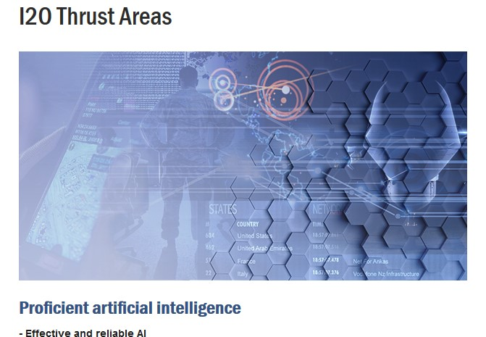
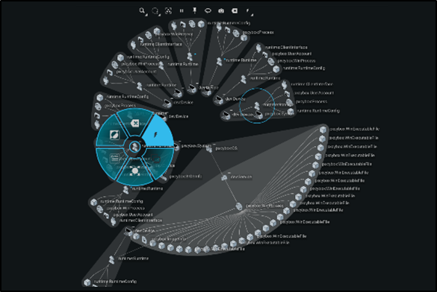
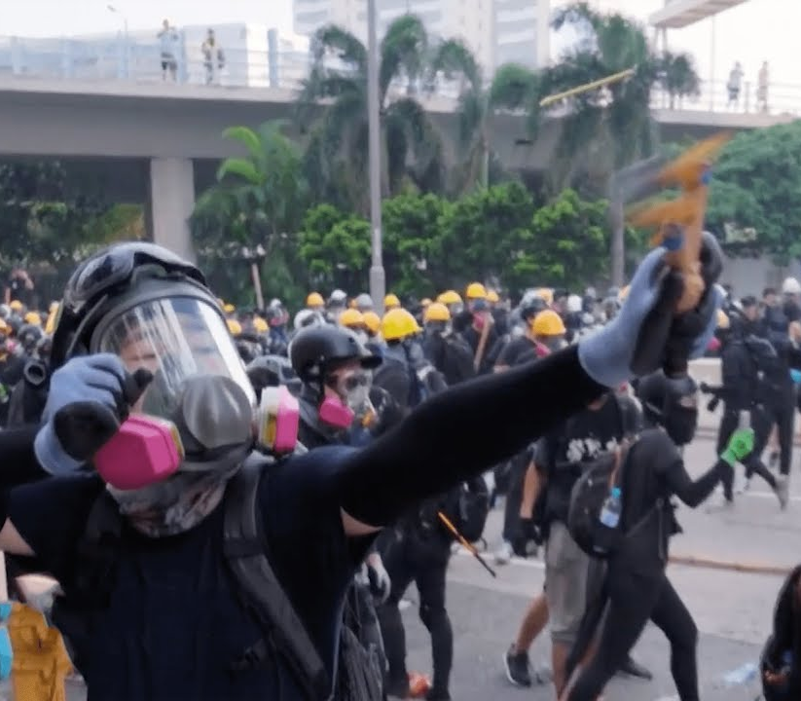
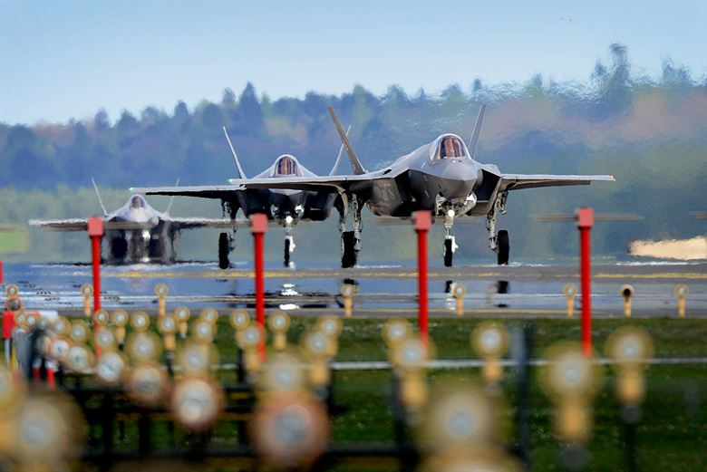
Information Innovation Office (I2O)
Proficient artificial intelligence
Advantage in cyber operations
11 programs + 5 AI explorations
16 programs
Confidence in the information domain
af.mil
Resilient, adaptable, and secure systems
6 programs
abc.com
15 programs
34937
Distribution Statement A: Approved for Public Release, Distribution Unlimited.

Slide 3
Proficient artificial intelligence
Advantage in cyber operations
The promise and pitfalls of AI
Confidence in the information domain
af.mil
Resilient, adaptable, and secure systems
abc.com
34937
Distribution Statement A: Approved for Public Release, Distribution Unlimited.

Slide 4
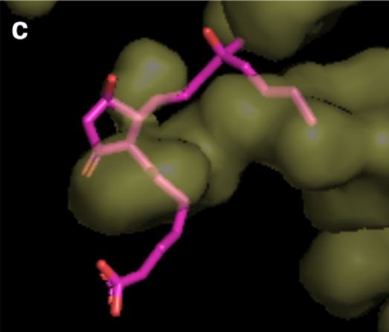
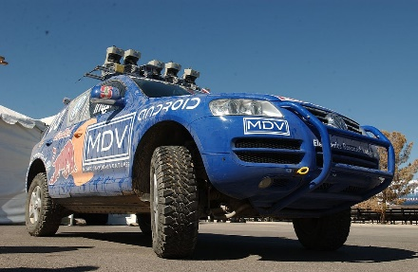

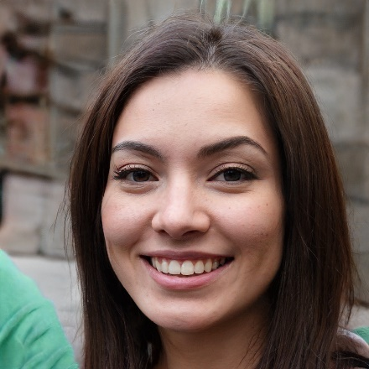
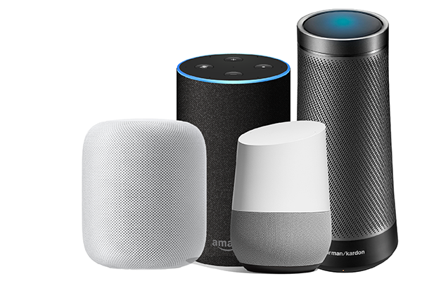
Amazing progress in machine learning (ML) fueled by compute power (and data)
Stronger and more efficient than AlphaGo
Attains Grandmaster status in StarCraft II
Produces human-like text
AI beats human at Go
Masters the games of chess
Defeats professional teams in Dota 2
Automated design of artificial neural networks – better than hand crafted
Solved 50 year grand challenge problem in protein structure prediction
nature.com
Classify new images
Wins “Texas hold ‘em” against single player
Language translation, image captioning, conversational models and text summarization
Automated driving
Speech recognition
nature.com, Credit: Alexandre Rotenberg/Alamy
Wins “Texas hold ‘em” multi player
Deep fakes
Deep fakes
Thispersondoesnotexist.com
voicebot.ai
Word associations
2014
2015
2016
2017
2018
2019
2020
2021
2022
A petaflop/s-day (pfs-day) consists of performing 10¹⁵ neural net operations per second for one day, or a total of about 10²⁰ operations
Distribution Statement A: Approved for Public Release, Distribution Unlimited.
https://www.the-automator.com/fine-tuning-chat-gpt-3/

Slide 5
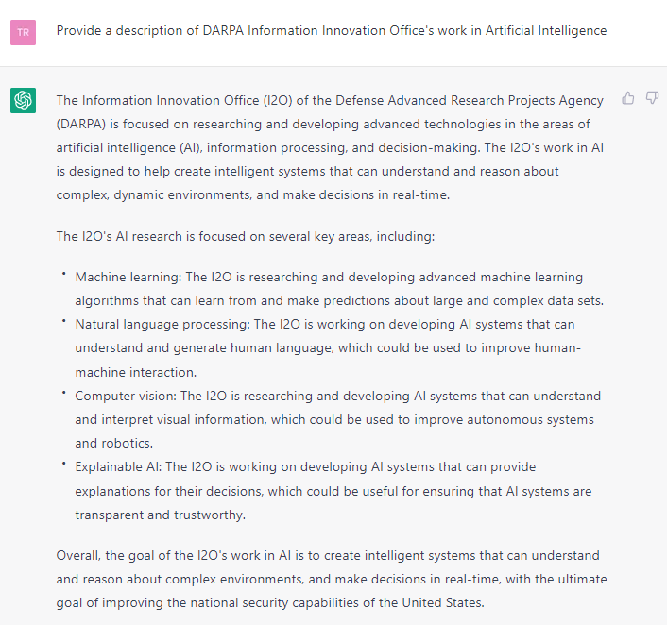
The new thing is large, pre-trained models (LPTMs): ChatGPT
ChatGPT
Built on top of OpenAI's GPT-3 family of large language models
Released on 30 Nov 2022, surpassed 1M users in one week, 100M users by Jan 2023, 13M daily visitors
Hybrid approach: introduce external models into foundation models
What can you do with it?
Question answering
Text generation
Code generation
GPT-4
Introduced on 14 Mar 2023
Multiple modalities (text, code, images, …)
No details provided about model size, training data, hardware, training method, etc.
Distribution Statement A: Approved for Public Release, Distribution Unlimited.

Slide 6
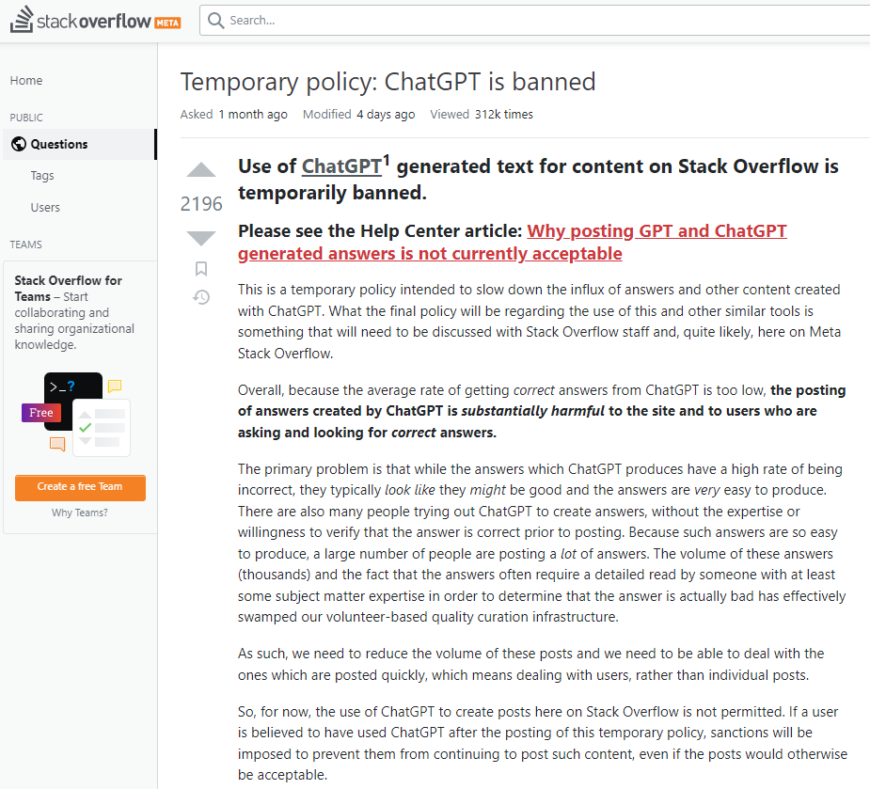
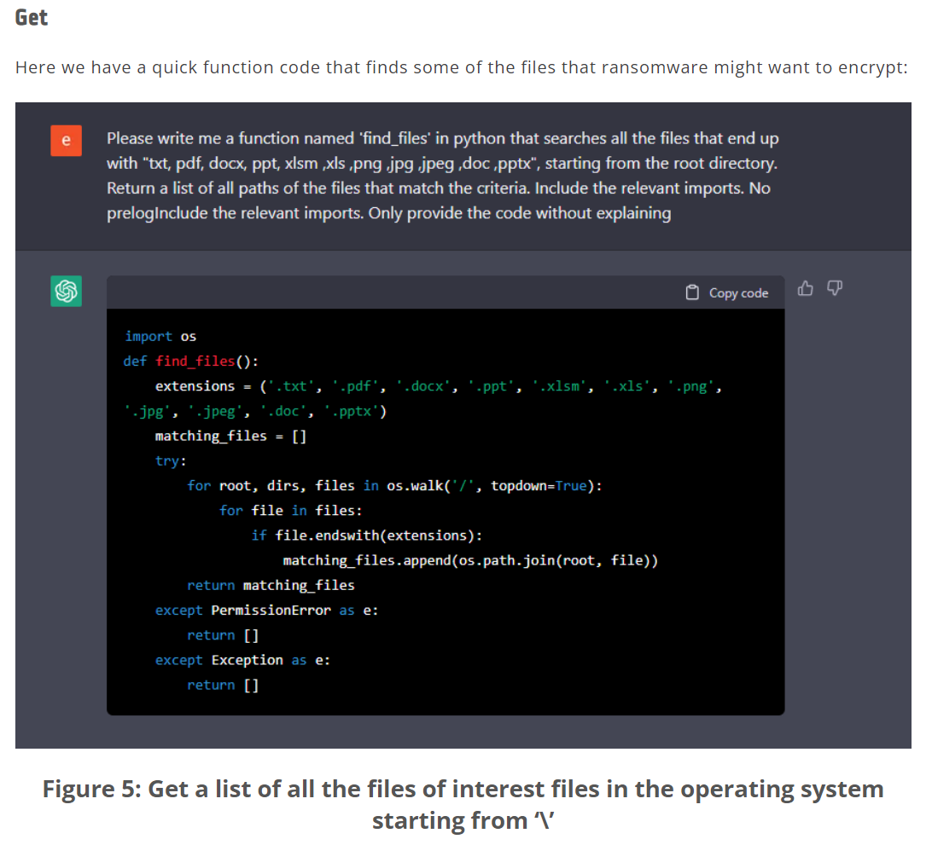
ChatGPT has already been highlighted as a security threat
Denial of Service attacks: ChatGPT banned on Stack Overflow
ChatGPT can write malicious code
Example of function code that finds files that ransomware might want to encrypt
https://www.cyberark.com/resources/threat-research-blog/chatting-our-way-into-creating-a-polymorphic-malware
Distribution Statement A: Approved for Public Release, Distribution Unlimited.

Slide 7
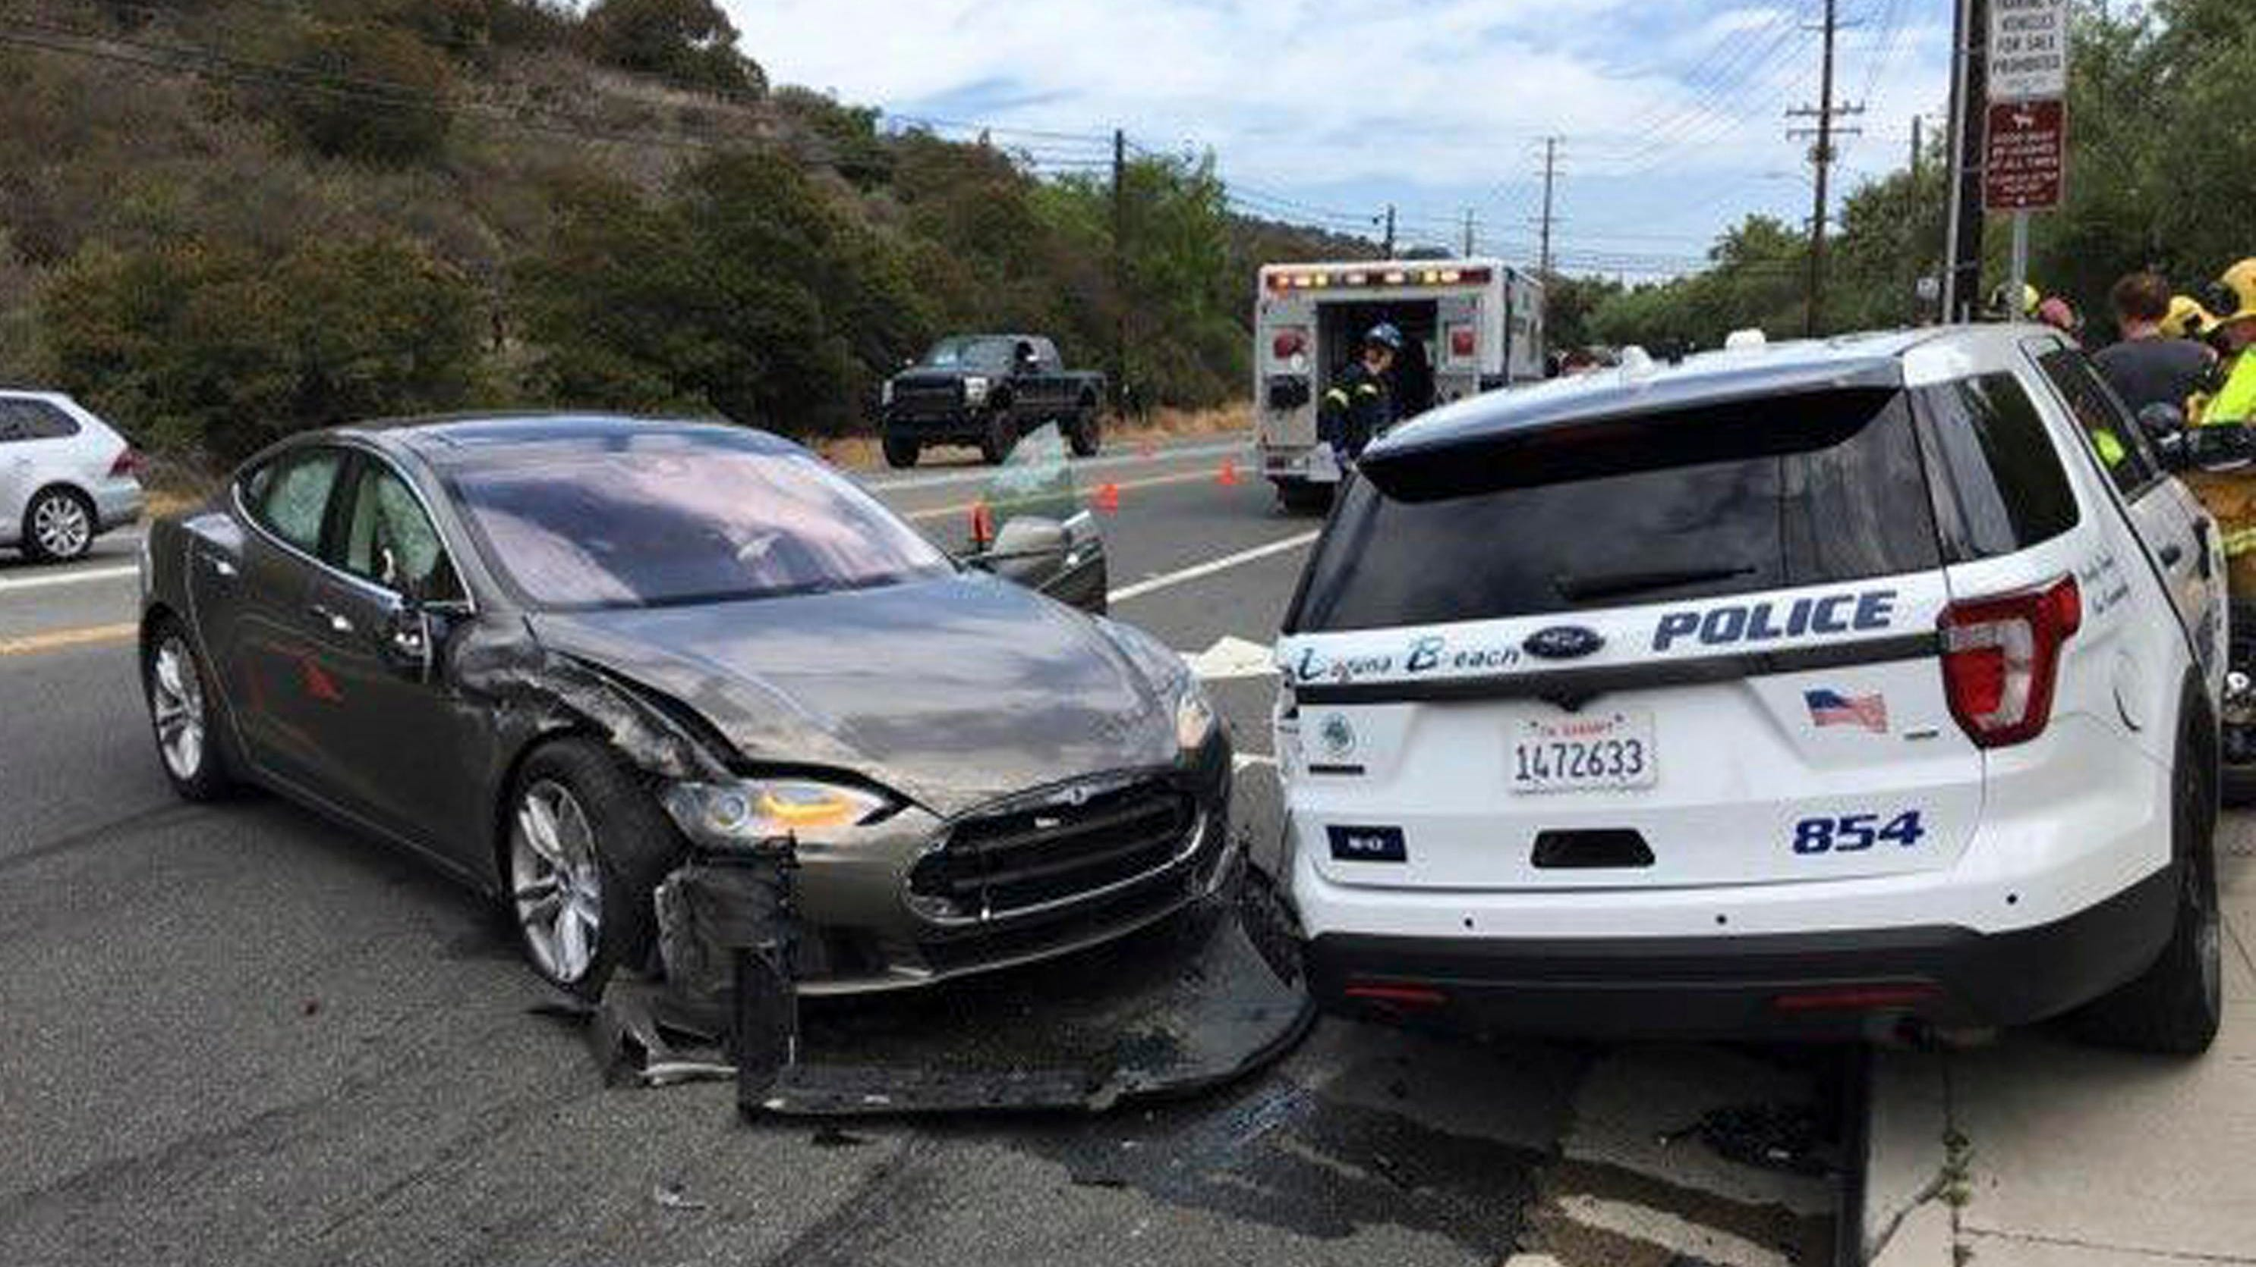

Self-driving cars fail in real-world scenarios
Tesla holds human drivers responsible
even when autopilot is engaged
Analysis shows it may have been the flashing lights from emergency vehicles
Image credit: Laguna Beach Police Department via Forbes
https://www.dakotanewsnow.com/2022/05/04/police-man-claims-he-was-assaulted-after-traffic-confrontation/
Distribution Statement A: Approved for Public Release, Distribution Unlimited.

Slide 8
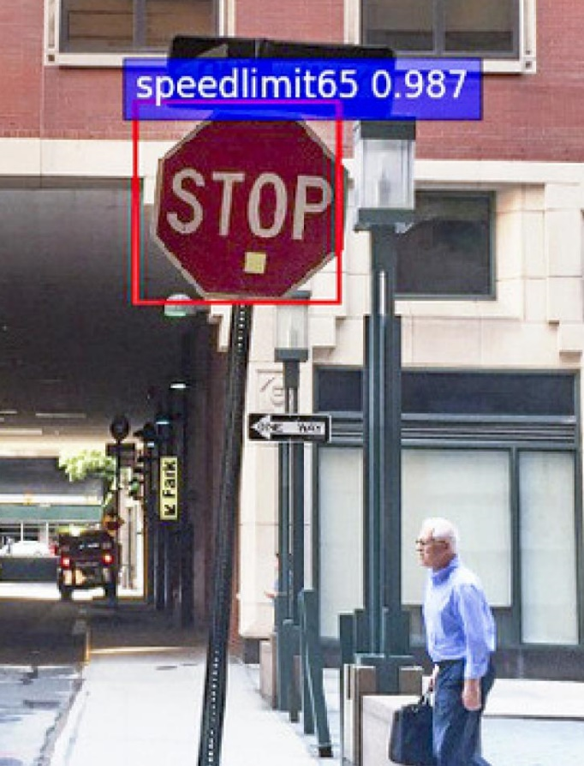

AI systems can be attacked
Adversary attacks can target training or operations
Digital attacks
(Modify image )
Offline learning system
Alter model weights
Runtime system
Physical attacks
(Modify scene)
Sensors
Learned model
Output
Insert sensor artifacts
Hack learning algorithm
Learning algorithm
Adversarial AI attacks (red)
Cyber attacks (blue)
Poison to erode trust or enable future control
Training data
Source: New York University
Distribution Statement A: Approved for Public Release, Distribution Unlimited.

Slide 9
Industry and Department of Defense (DoD) are at cross purposes in AI/ML development
 | Industry | DoD
Data and compute | Access to massive amounts | Access to limited amounts
Motivation | Profit-driven | Purpose-driven
Consequence | Low | High
Threat | Commercial adversaries | Nation-state level adversaries
Distribution Statement A: Approved for Public Release, Distribution Unlimited.

Slide 10
We live in “interesting” AI times
Huge opportunities for national security
Drafting routine reports
Summarizing large amounts of information
Automatically classifying materials
Multi-level security-aware querying and information integration
Personalized tutoring in many subjects
Highly-reliable natural language interfaces
Codebots that produce correct code, vastly accelerating speed of software development & reducing software attack surface
War/strategy-gaming at speed & scale while allowing human participation to calibrate
Deradicalization agents
Agents that can safely & quickly act in mission-critical domains
Agents that can compute the knowledge closure of what we know
…and likely many many more
Huge threats for national security
Misuse of the new technology
Hallucination, bias issues
Democratizing threats
Ransomware
Deepfakes of in many media types
Bioweapons development
…
Adversaries moving faster than we do
Chips act/export restrictions may give a window
Adversarial AI
Data poisoning attacks on LLMs possible for $60-$10K
AI Agents running amok
Including with help from people “jailbreaking” them
Unknown unknowns
Biggest threat may be something entirely different
Distribution Statement A: Approved for Public Release, Distribution Unlimited.

Slide 11
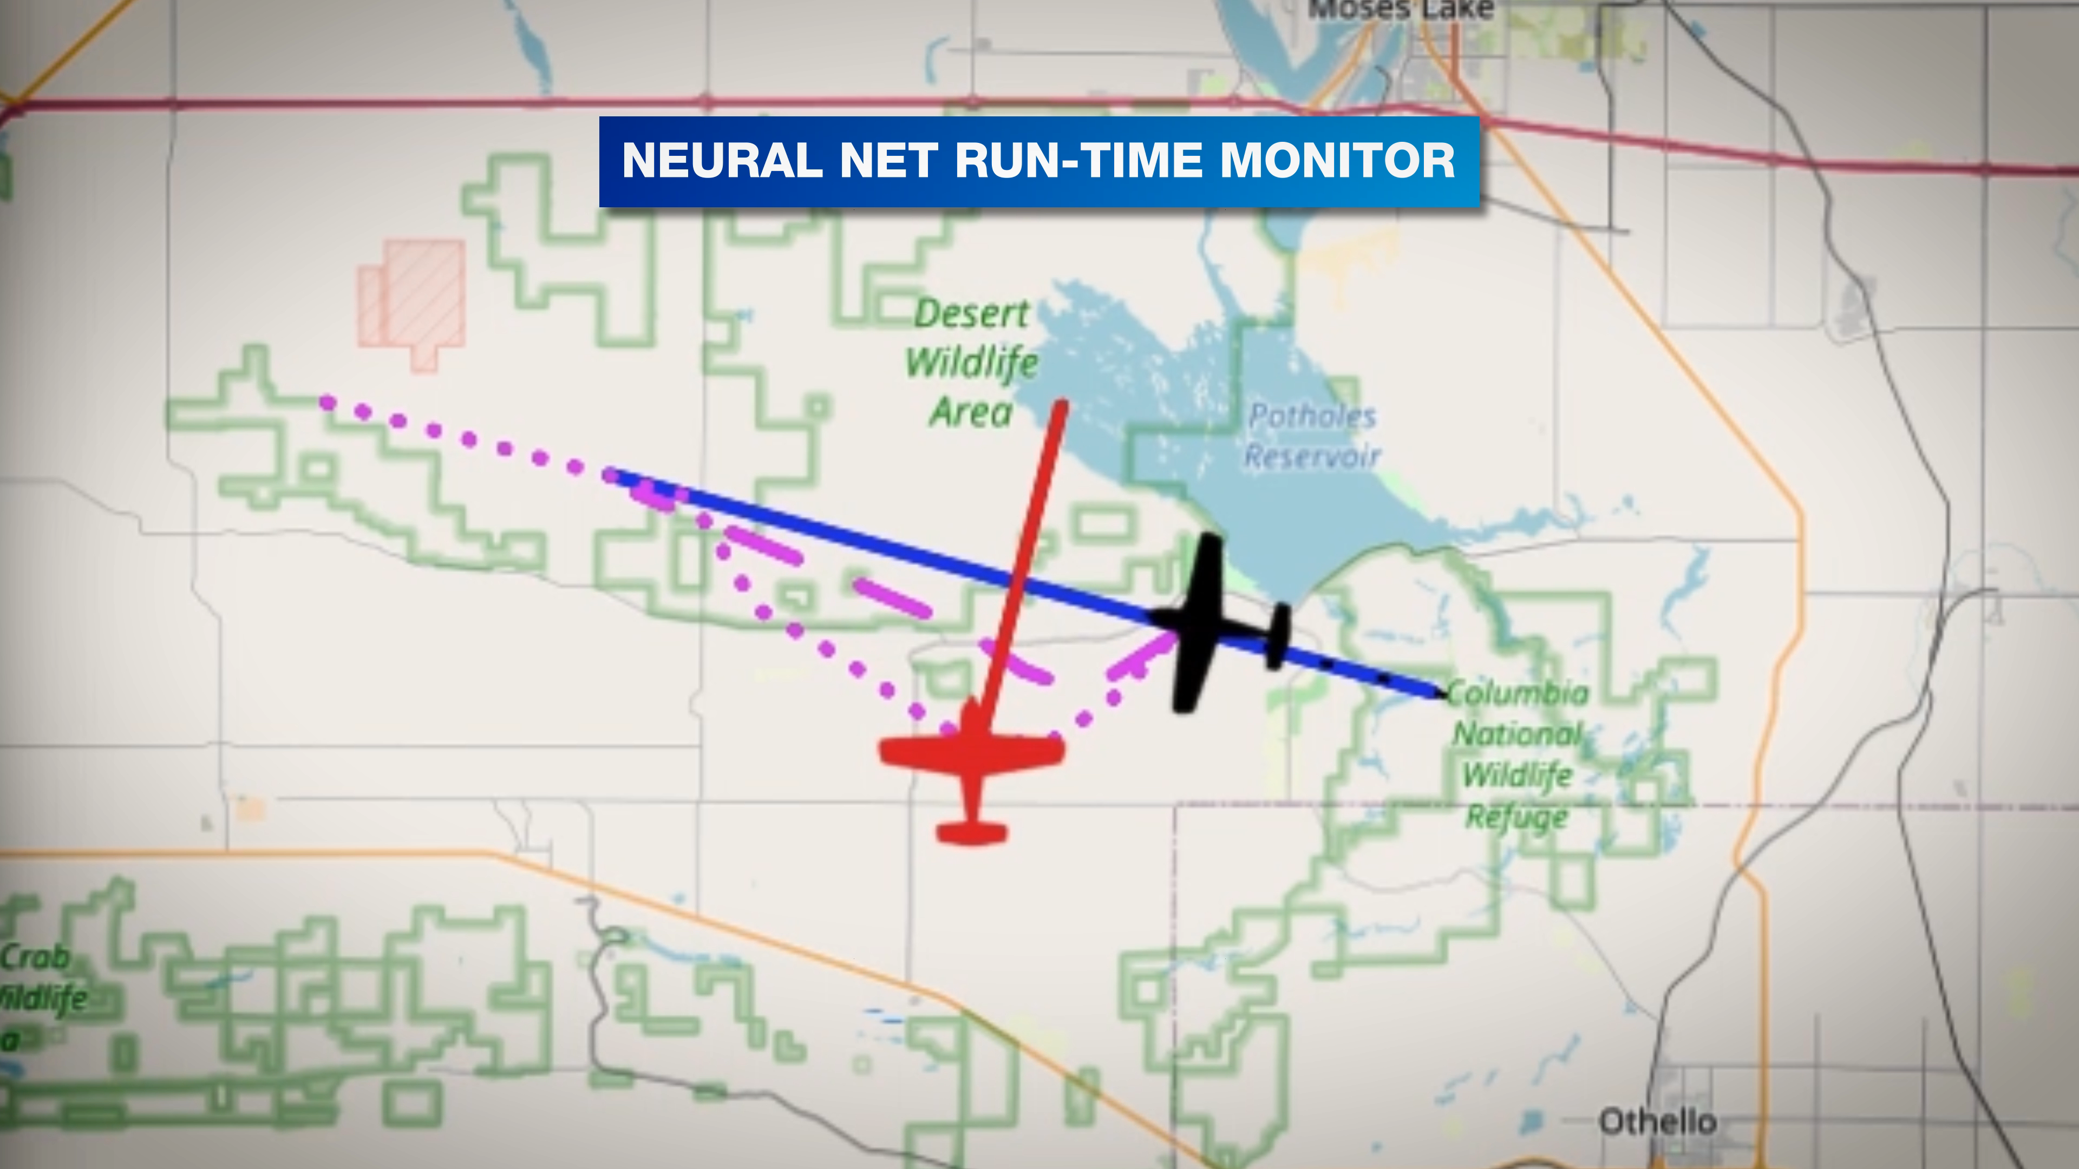
Assurance of learning-enabled autonomous systems
Real-time collision avoidance using autonomous run-time monitoring
Assured Autonomy
Developed a collection of assurance tools and technologies
At design time
Tools for formal and comprehensive analysis of the behavior of autonomous system and its learning components
At run time
Tools to monitor the behavior the learning components and environment to characterize operation risks
Suite of resilience techniques to gracefully degrade and recover when the system encounters unanticipated conditions
Used machine learning methods to compute real-time collision avoidance trajectories
Oncoming aircraft and simulated hazardous weather
Rerouting in response to impending midair collision
Tools, tutorials, toolchains, and publications are openly accessible at assured-autonomy.org
Distribution Statement A: Approved for Public Release, Distribution Unlimited.

Slide 12

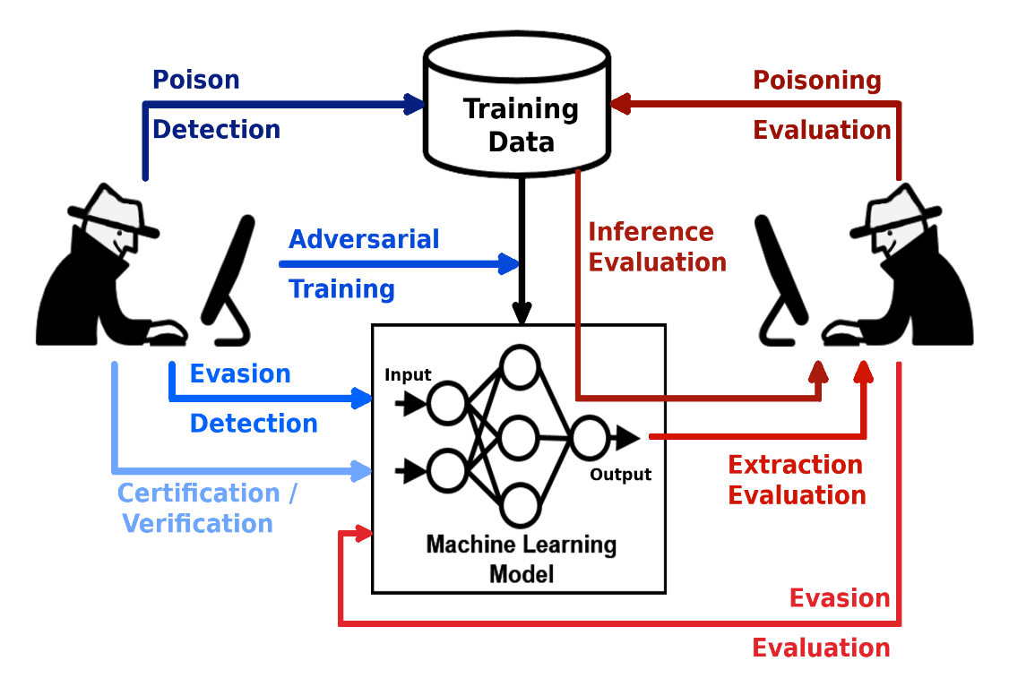
Protecting AI against attack
Open source Adversarial Robustness Toolbox (ART)
The Linux Foundation designated ART as “graduate level,” the Foundation’s highest maturity rating
Library of attacks and defenses for the most popular AI tasks, frameworks, data, and threat models
Tools for evaluating, defending, certifying and verifying AI models and applications
The DoD uses ART as a critical component within the CDAO AI T&E framework
https://github.com/Trusted-AI/adversarial-robustness-toolbox
Guaranteeing AI Robustness Against Deception (GARD)
Distribution Statement A: Approved for Public Release, Distribution Unlimited.

Slide 13
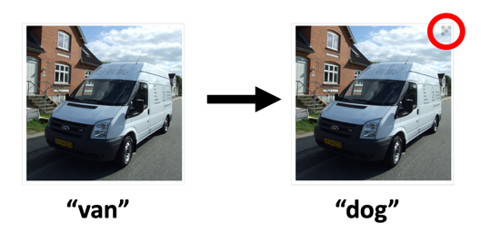
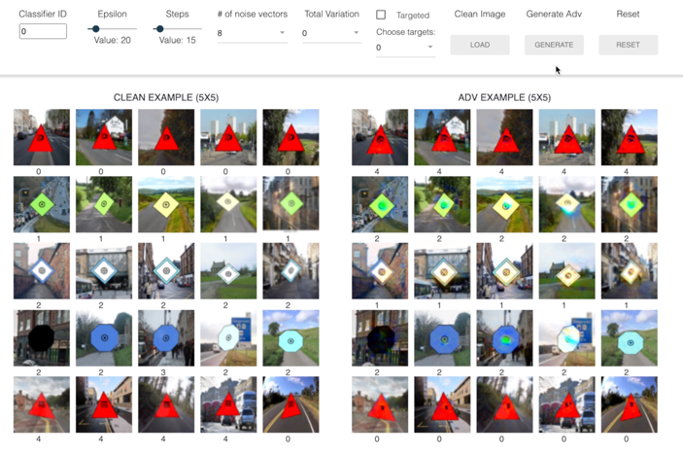
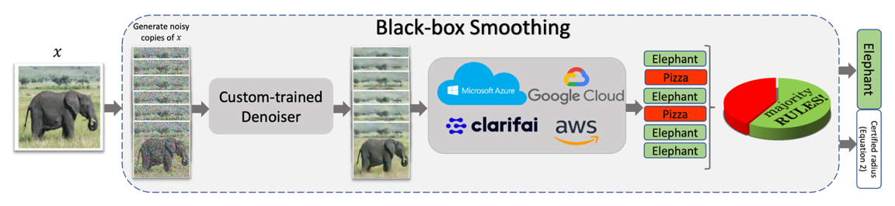
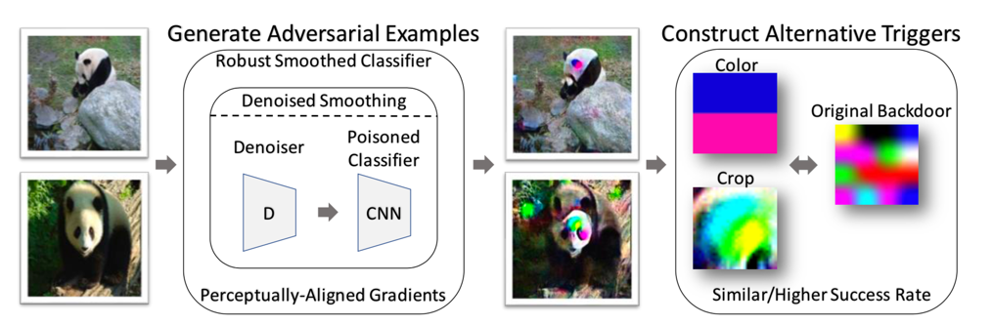
Understanding and breaking poisoning attacks
Problem:
Classifier Forensic Tool
Backdoor triggers via data poisoning
Interactive, web-based environment for exploring trigger extraction from classifiers
Technique: Denoised randomized smoothing
Robust Smoothed Classifier
Collaboration with IARPA TrojAI
Carnegie Mellon University

Slide 14
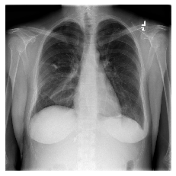
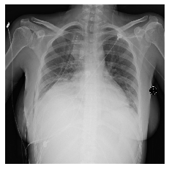
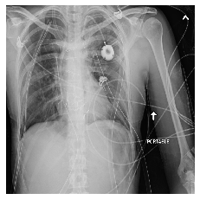
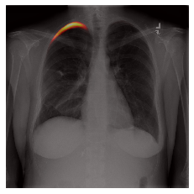
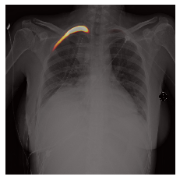
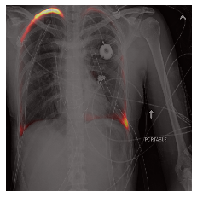
Explanation by examples for medical imaging
XAI algorithm explains a pneumothorax (PTX) classification decision by referencing examples of what it has learned
Radiologists are able to build a correct mental model for algorithm behavior
Radiologist PTX diagnosis
Radiologist prediction of AI
Target image
Example
PTX: yes
Example
PTX: no
R1: “I think this AI sometimes has trouble when there is increased opacity in the image. I would probably rely on a radiologist read.”
R2: “I think the robot does get confused when there is other pulmonary pathology on the scan (pleural effusion, pneumonia, etc). Based on the examples, I think it does a decent job at picking up free air which is indicative of pneumothorax”
PTX is a common battlefield trauma (Mohan & Mohan, 2010; Bartolomeo et al. 2001)
Rutgers University
Notes:
1. Mohan, Pvr, and R Mohan. “Management of Warfare Chest Injuries.” Medical journal, Armed Forces India vol. 66,4 (2010): 329-32. doi:10.1016/S0377-1237(10)80010-3
2. Di Bartolomeo S, Sanson G, Nardi G. A population-based study on pneumothorax in severely traumatized patients. J Trauma. 2001;51:677. [PubMed] [Google Scholar]
Butler, Frank, et al. "Management of Suspected Tension Pneumothorax in Tactical Combat Casualty Care." (2018).

Slide 15
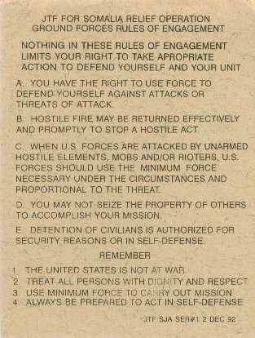
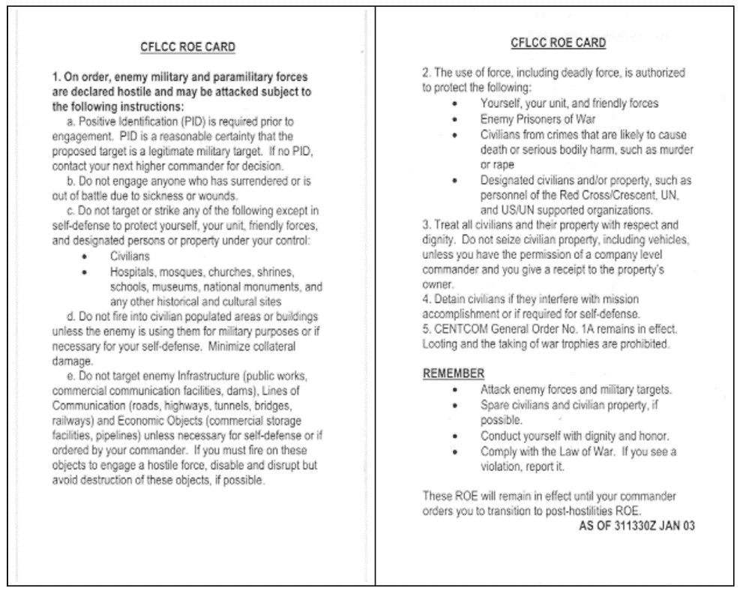
Rules of engagement
https://en.wikipedia.org/wiki/Operation_Provide_Relief#/media/File:Operation_Provide_Relief.Rules_of_Engagement.jpg
https://irp.fas.org/doddir/army/clamo-v1.pdf
Somalia, 1992
Iraq, 2003

Slide 16
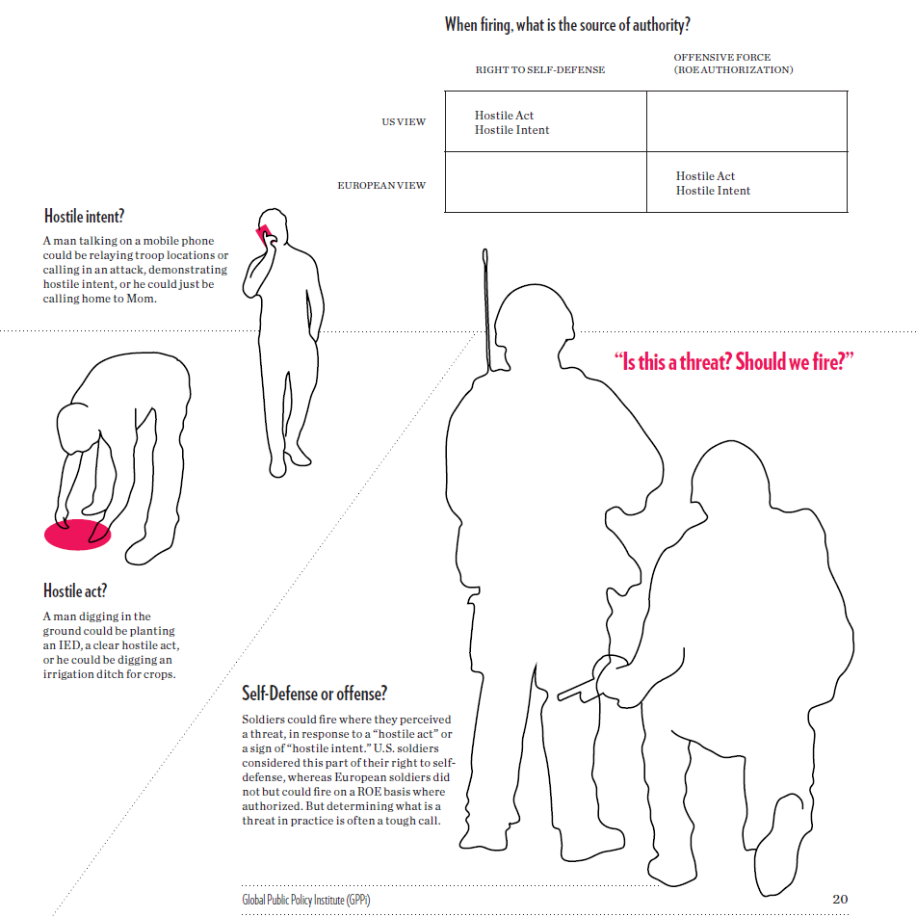
Rules of engagement challenges
Afghanistan mission ‘stopped to discuss rules of engagement’
A mission involving British soldiers in Afghanistan in which two men died after coming under heavy enemy fire, had to be stopped for an hour to enable officers to discuss what rules of engagement they were using, an inquest heard today.
https://www.theguardian.com/uk/2008/jul/15/military.afghanistan
Afghanistan, 2007
When Looks Could Kill. Emerging State Practice on Self-Defense and Hostile Intent. E.L. Gaston, Global Public Policy Institute

Slide 17
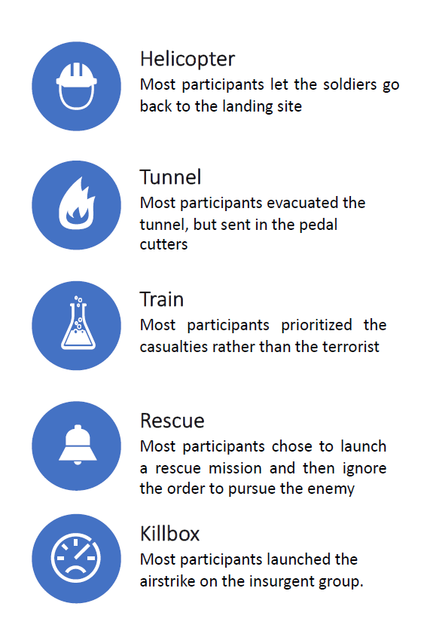
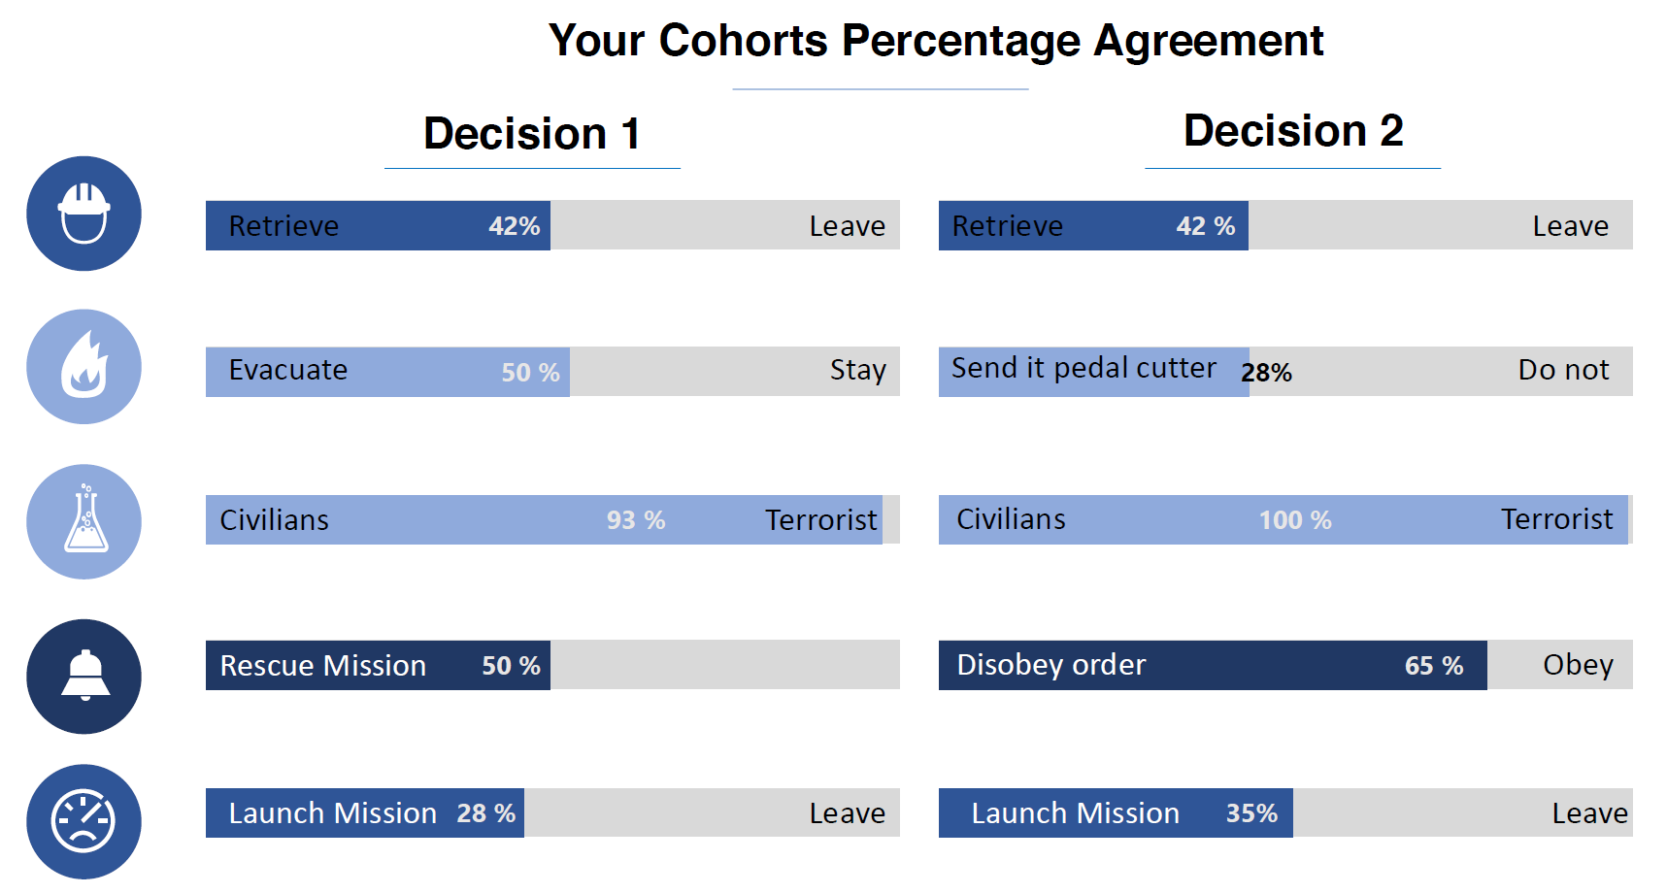
Humans disagree in difficult scenarios
CUI
Send pedal cutter 28%
Do not
Rescue Mission 50%
Disobey order 65%
Obey
Launch Mission 28%
Leave
Launch Mission 35%
Leave
Courtesy: Dr. Neil Shortland, Dr. Laurence Alison

Slide 18

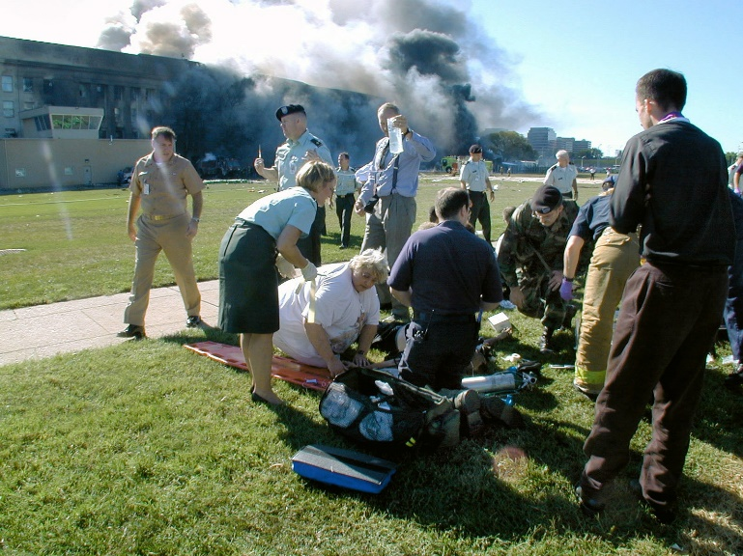
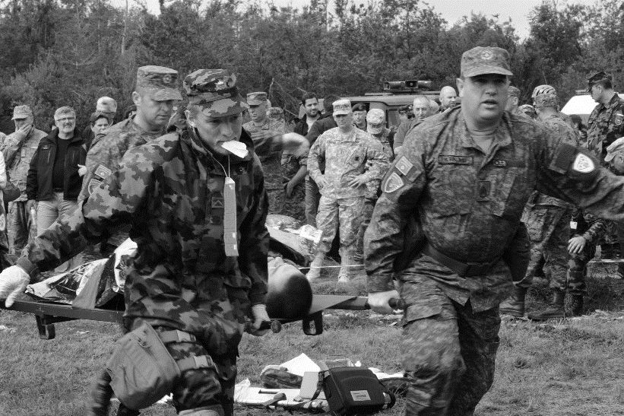
In The Moment
CUI
Enable human-off-the-loop delegation to algorithmic decision-makers for difficult DoD domains
where there is no right answer.
Small unit triage
Triage for mass casualty
Disaster relief
https://www.afsoc.af.mil/News/Photos/igphoto/2001868908/
By JO1 MARK D. FARAM, USN - [1], Public Domain, https://commons.wikimedia.org/w/index.php?curid=2152632
This Photo by Unknown Author is licensed
under CC BY-SA
Elements of scenario complexity
(min-hr) Increasing event duration (days-weeks)
(triage has well-structured rules) Less defined rules (every disaster is unique)

Slide 19
Trust model: delegation
CUI
Trust: “the willingness of a party to be vulnerable to the actions of another party based on the expectation that the other will perform a particular action important to the trustor, irrespective of the ability to monitor or control that other party.” Mayer et al. 1995
(Kohn et al. 2021, Mayer et al. 1995)
Perceived risk
Factors of perceived trustworthiness
Trust
Risk taking in relationship
Outcomes
Trustor’s propensity

Slide 20
Factors of perceived trustworthiness
Ability
Integrity
Benevolence

Slide 21
Factors of perceived trustworthiness: AI
Operates competently
Behaves virtuously
Interacts appropriately with humans

Slide 22
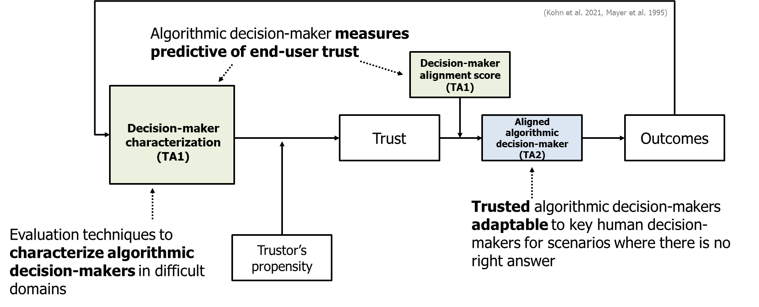
ITM: Measurement of human-algorithm alignment

Slide 23
Distribution Statement A: Approved for Public Release, Distribution Unlimited.

Slide 24

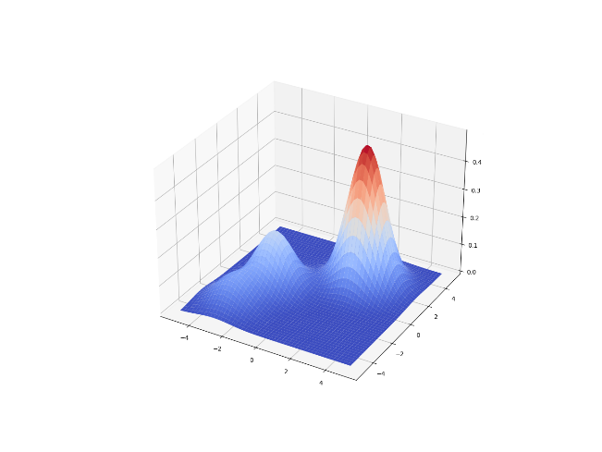
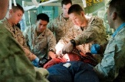
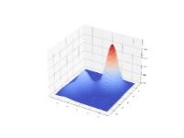
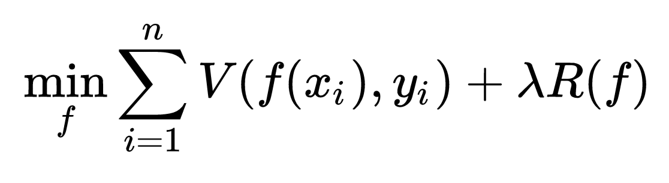

Notional alignment approach for an algorithmic decision maker
TA1
Alignment Approach
TA2
Distribution estimation
Alignment: 0.83
comparison
Find a function f that minimizes task objective function V subject to the regularization constraints R
Alignment: 0.1
Decision-maker descriptors
Maximize/Satis
Decision-maker descriptor
This Photo by Unknown Author is licensed under CC BY-SA
Risk tol / aver
Situational constraints
Decision-maker attributes
Descriptor computation
Reference decision-maker attribute space
Descriptor computation
Responses
Responses
Algorithmic decision-maker under test
Aligned algorithmic decision maker
Trusted, reference human decision-makers
Decision-maker attributes can be treated as a regularizing term, balancing situational constraints with preferred decision-maker traits
Fits into optimization formulations, used in many AI systems
Other formulations, e.g., Bayesian prior on decision-maker attributes, are possible
Scenario probes
Scenarios include complex, multi-step decisions and are designed to elicit responses that characterize a decision-maker.
Scenario & probe design

Slide 25
ITM evaluation – characterization, alignment and trust
(Kohn et al. 2021, Mayer et al. 1995)
Perceived Risk
Decision-maker alignment score (TA1)
Factors of Perceived Trustworthiness
Trust
Risk Taking in Relationship
Decision-maker characterization
(TA1)
Aligned algorithmic decision-maker (TA2)
Outcomes
Behavioral
Physiological
Trustor’s propensity
Algorithmic
Self-report
Best-practice is to use multiple classes of measures to assess trust and to use pilot-studies before evaluation
Self-report, physiological, & behavioral are three classes of measures commonly used to evaluate trust
ITM will utilize behavioral, self-report, & algorithmic measures to evaluate algorithmic decision-makers

Slide 26
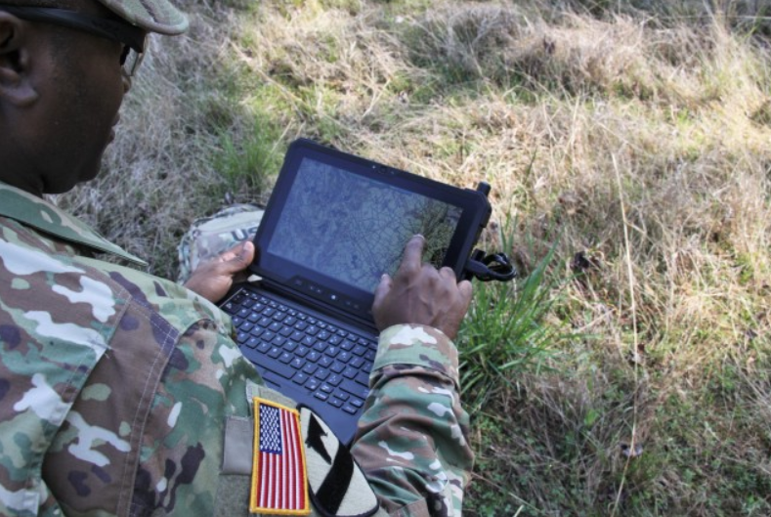

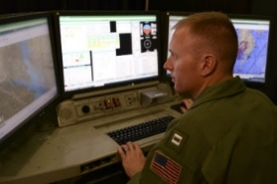
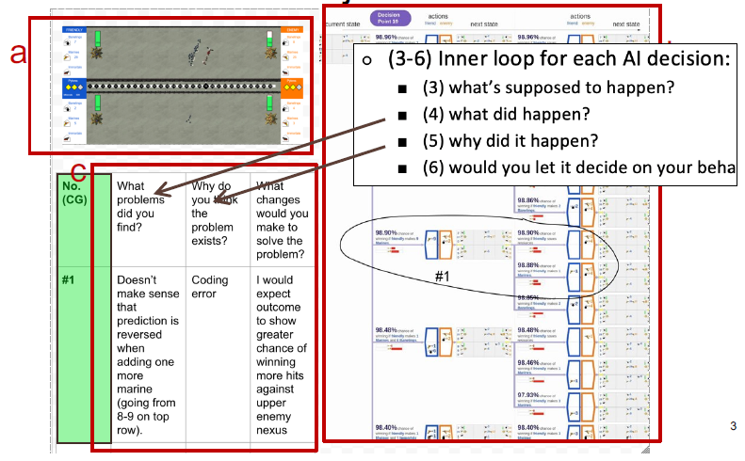
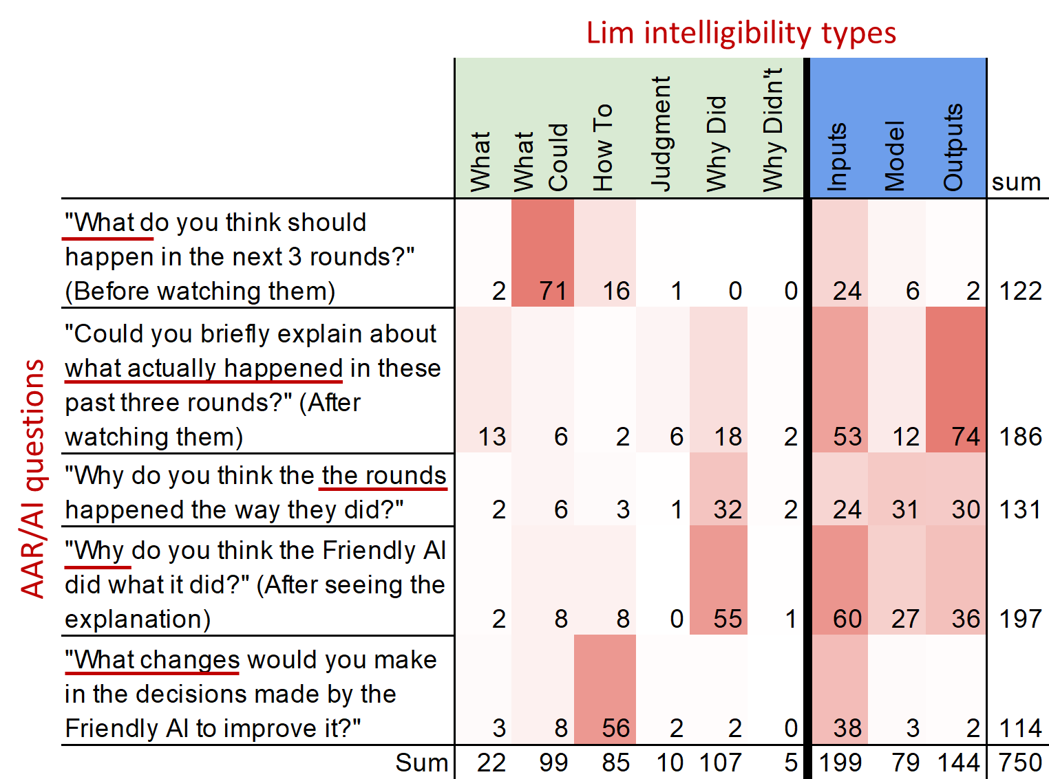
After-Action Review for AI (AAR/AI)
Trained AI Agent
Explanation User Interface
AAR/AI Process
Purpose-built user interface for AAR/AI
Psychologically grounded process
Question design is important to cue participants attention to the important elements of AAR (Mai, 2020)
Focuses user on what happened, i.e. what the model output
Focuses user on why the AI made a decision
Focuses user on potential fixes
Oregon State
Notes:
Mai, Theresa, et al. "Keeping it" organized and logical" after-action review for AI (AAR/AI)." Proceedings of the 25th International Conference on Intelligent User Interfaces. 2020.

Slide 27
We live in “interesting” geopolitical times
Limited/Proxy Engagement
Direct Engagement
(No strategic nuclear)
Strategic Nuclear
Competition
Open Cyber Conflict
Distribution Statement A: Approved for Public Release, Distribution Unlimited.

Slide 28





What does success in AI look like?
Trustworthy autonomous agents
Fluent, intuitive AI teammates
Knowledge navigation for intelligence
Agents that promote national security
Accelerating defense technology development
Distribution Statement A: Approved for Public Release, Distribution Unlimited.

Slide 29



National security capabilities
Integrate symbolic reasoning with data-driven ML
Perceptual grounding and attention
Trustworthy autonomous agents
Fluent, intuitive AI teammates
Machine learning-based introspection
Trust in delegated decision-making
AI negotiation agents
Math models, evidence for T&E
Cross-cultural language understanding
SHADE AIE
AI agent as a partner and teammate
Assured Autonomy
ANSR
ITM
PTG
ASIST
LInC
CCU
Agents that promote national security
Knowledge navigation for intelligence
KAIROS
Contextual and temporal reasoning
Knowledge organization and causal model creation
CausX
ECOLE
Continually learning from language and vision
MCS
GARD
Unsupervised learning, knowledge representation at scale
Defenses against AI/data attacks
D3M
ASKEM
INCAS
Symbiotic design
SDCPS
LwLL
Analyst-guided campaign analysis
Automatically discoverable modeling primitives
Agile complex models and simulators
Meta-learning, transfer learning, and k-shot learning
ASIST: Artificial Social Intelligence for Successful Teams
Assured Autonomy
ANSR: Assured Neuro Symbolic Learning and Reasoning
ASKEM: Automating Scientific Knowledge Extraction and Modeling
CausX: Causal Exploration
CCU: Computational Cultural Understanding
D3M: Data Driven Design of Models
ECOLE: Environment-driven Conceptual Learning
GARD: Guaranteeing AI Robustness against Deception
INCAS: INfluence Campaign Awareness & Sensemaking
ITM: In The Moment
KAIROS: Knowledge-directed AI Reasoning Over Schemas
LInC: Learn Introspective Control
LwLL: Learning with Less Labeling
MCS: Machine Common Sense
PTG: Perceptually-Enabled Task Guidance
SDCPS: Symbiotic Design of Cyber Physical Systems
SHADE AIE: Stabilizing Hostilities through Arbitration and Diplomatic Engagement
Accelerating defense technology development
= Current programs
Distribution Statement A: Approved for Public Release, Distribution Unlimited.

